Slide 1

Project Procurement Management
IT/Software Project Management
IT/CS/SE MSc
1

Slide 2
What is project procurement management?
It is part of project management that includes the processes required to acquire goods and services to attain project scope from outside the performing organization.
Other terms include purchasing and outsourcing
In 2017, the global IT outsourcing industry generated 88.9 billion U.S. dollars in revenue.
The Global IT Outsourcing Market to grow at a compound annual growth rate (CAGR) of 4.42% during the period 2018-2022.

Slide 3
Why we outsource?
To reduce both fixed and recurrent costs
To allow the client organization to focus on its core business
To access skills and technologies
To provide flexibility
To increase accountability

Slide 4
Project procurement management processes
Processes include:
Procurement Planning: determining what to procure, when, and how.
Solicitation Planning: describing requirements for the products or services desired from the procurement and identifying potential sources or sellers (contractors, suppliers, or providers who provide goods and services to other organizations).
Solicitation: obtaining information, quotes, bids, offers, or proposals from sellers, as appropriate.

Slide 5
…processes continued
Source Selection: choosing from among potential suppliers through a process of evaluating potential sellers and negotiating the contract.
Contract Administration: managing the relationship with the selected seller.
Contract Closeout: completing and settling each contract, including resolving any open items.

Slide 6
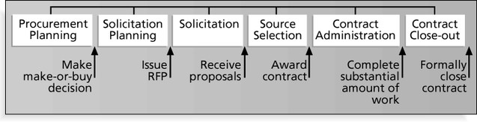
Project Procurement Management Processes and Key Outputs

Slide 7
Procurement Planning
Identifying which project needs can best be met by using products or services outside the organization.
If there is no need to buy any products or services from outside the organization, then there is no need to perform any of the other procurement management processes.

Slide 8
…Procurement Planning
Procurement planning involves identifying which project needs can be best met by using products or services outside the organization.
It includes deciding
Whether to procure …?
How to procure
What to procure
How much to procure
When to procure

Slide 9
Procurement planning tools and techniques
Make-or-buy analysis: determining whether a particular product or service should be made or performed inside the organization or purchased from someone else. Often involves financial analysis
Experts, both internal and external, can provide valuable inputs in procurement decisions

Slide 10
Make-or buy example
Assume you can lease an item you need for a project for $800/day. To purchase the item, the cost is $12,000 plus a daily operational cost of $400/day.
How long will it take for the purchase cost to be the same as the lease cost?

Slide 11
Make-or buy …solution
▣ Set up an equation so both options, purchase and lease, are equal.
▣ In this example, use the following equation. Let d be the number of days to use the item:
$12,000 + $400d = $800d
Subtracting $400d from both sides, you get:
$12,000 = $400d
Dividing both sides by $400, you get: d = 30
▣ If you need the item for more than 30 days, it is more economical to
purchase it.

Slide 12
Contracts
A contract is a mutually binding agreement that obligates the seller to provide the specified products or services and obligates the buyer to pay for them.
Contracts can clarify responsibilities and sharpen focus on key deliverables of a project.
Because contracts are legally binding, there is more accountability for delivering the work as stated in the contract.
A recent trend in outsourcing is the increasing size of contracts.

Slide 13
Types of contracts
Fixed-price or lump-sum: involve a fixed total price for a well-defined product or service
Cost-reimbursable: involve payment to the seller for direct and indirect costs
Time and material contracts: hybrid of both fixed-price and cost-reimbursable, often used by consultants
Unit price contracts: require the buyer to pay the seller a predetermined amount per unit of service

Slide 14
Cost reimbursable contracts
Cost plus incentive fee (CPIF): the buyer pays the seller for allowable performance costs plus a predetermined fee and an incentive bonus
Cost plus fixed fee (CPFF): the buyer pays the seller for allowable performance costs plus a fixed fee payment usually based on a percentage of estimated costs
Cost plus percentage of costs (CPPC): the buyer pays the seller for allowable performance costs plus a predetermined percentage based on total costs

Slide 15
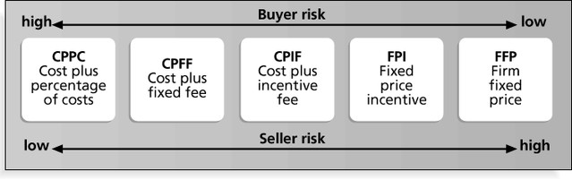
Contract types versus risk
Mekonnen Wagaw | Faculty of Computing | BiT | Bahir Dar
University
15

Slide 16
Procurement management plan
Describes how the procurement processes will be managed, from developing documentation for making outside purchases or acquisitions to contract closure.
Contents vary based on project needs.

Slide 17
Statement of Work (SOW)
A statement of work is a description of the work required for the procurement.
If a SOW is used as part of a contract to describe only the work required for that particular contract, it is called a contract statement of work.
A SOW is a type of scope statement.
A good SOW gives bidders a better understanding of the buyer’s
expectations.

Slide 18
Statement of Work (SOW) Template
Scope of Work: Describe the work to be done to detail. Specify the hardware and software involved and the exact nature of the work.
Location of Work: Describe where the work must be performed. Specify the location of hardware and software and where the people must perform the work
Period of Performance: Specify when the work is expected to start and end, working hours, number of hours that can be billed per week, where the work must
be performed, and related schedule information.
IV.
Deliverables Schedule:
specify when they are due.
Applicable Standards:
List specific deliverables, describe them in detail, and
V.
Specify any company or industry-specific standards that
are relevant to performing the work.
VI.
Acceptance Criteria:
work is acceptable.
Special Requirements:
Describe how the buyer organization will determine if the
VII.
Specify any special requirements such as hardware or
software certifications, minimum degree or experience level of personnel, travel
requirements, and so on.

Slide 19
Plan contracting
Involves preparing several documents needed for potential sellers to prepare their responses and determining the evaluation criteria for the contract award.
Request for Proposals (RFP): Used to solicit proposals from prospective
sellers.
A proposal is a document prepared by a seller when there are different approaches for meeting buyer needs.
Requests for Quotes (RFQ): Used to solicit quotes or bids from prospective suppliers.
A bid, also called a tender or quote (short for quotation), is a document prepared by sellers providing pricing for standard items that have been clearly defined by the buyer.

Slide 20
Outline for a Request for Proposal (RFP)
Purpose of RFP
Organization’s Background
Basic Requirements
Hardware and Software Environment
Description of RFP Process
Statement of Work and Schedule Information
Possible Appendices
Current System Overview
System Requirements
Volume and Size Data
Required Contents of Vendor’s Response to RFP
Sample Contract

Slide 21
Evaluation criteria
It’s important to prepare some form of evaluation
criteria, preferably before issuing a formal RFP or RFQ.
Beware of proposals that look good on paper; be sure to evaluate factors, such as past performance and management approach.
Can require a technical presentation as part of a proposal.

Slide 22
Requesting seller responses
Deciding whom to ask to do the work, sending appropriate documentation to potential sellers, and obtaining proposals or bids.
Organizations can advertise to procure goods and services in several ways:
Approaching the preferred vendor.
Approaching several potential vendors.
Advertising to anyone interested.
A bidders’ conference can help clarify the buyer’s expectations.

Slide 23
Selecting sellers
Also called source selection.
Involves:
Evaluating proposals or bids from sellers.
Choosing the best one.
Negotiating the contract.
Awarding the contract.

Slide 24
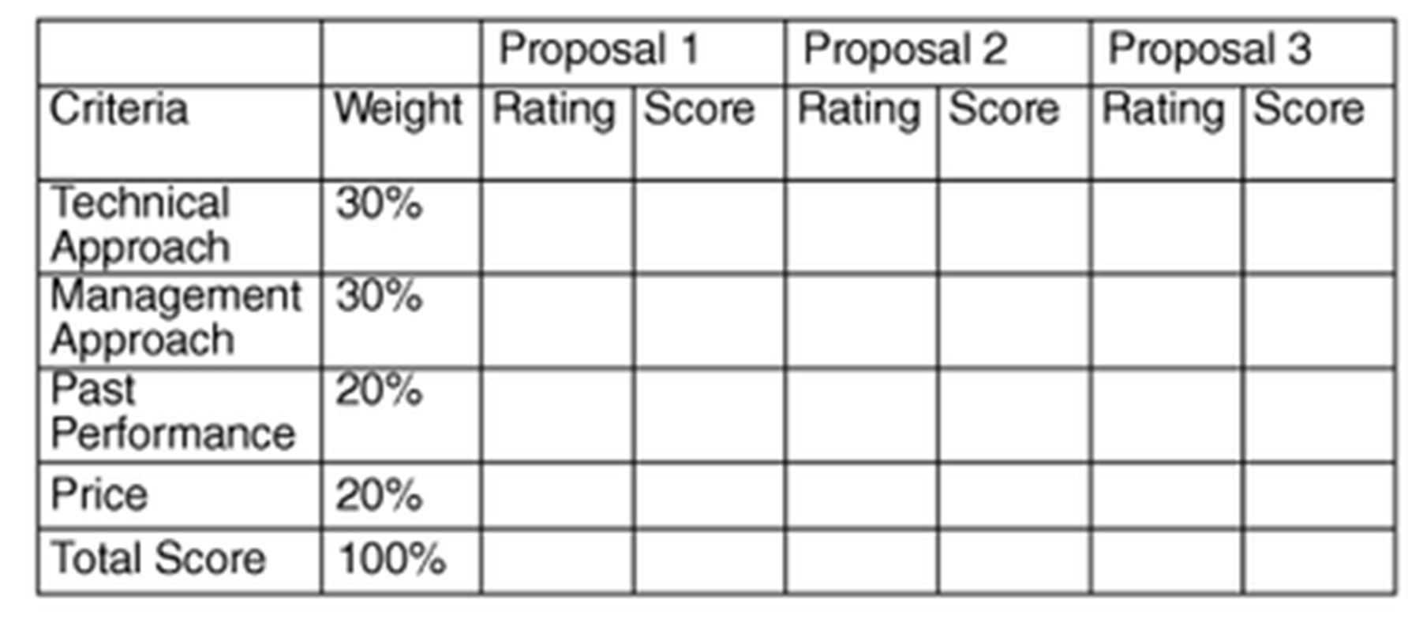
Sample proposal evaluation sheet

Slide 25
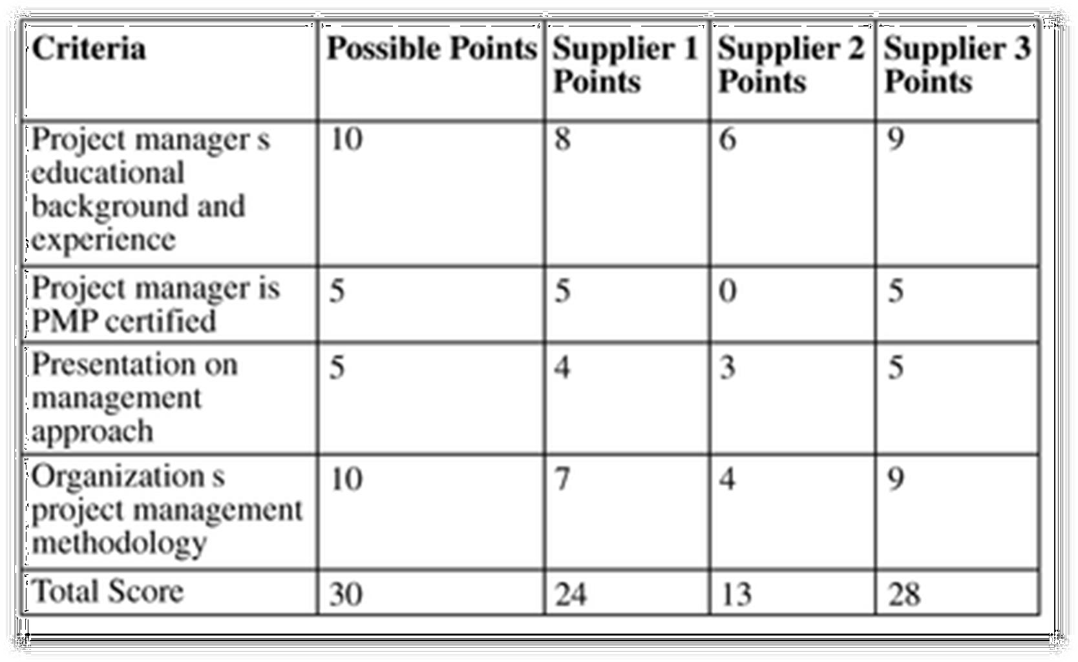
Detailed criteria for selecting suppliers

Slide 26
Be careful in selecting suppliers and writing their contracts
Many dot-com companies were created to meet potential market needs, but many went out of business, mainly due to poor business planning, lack of senior management operations experience, lack of leadership, and lack of visions.
Check the stability of suppliers
Even well-known suppliers can impede project success. Be sure to write and manage contracts well with all suppliers.

Slide 27
Seller selection process
Organizations often do an initial evaluation of all proposals and bids and then develop a short list of potential sellers for further evaluation.
Sellers on the short list often prepare a best and final offer
Final output is a contract signed by the buyer and the selected seller.

Slide 28
Administering the contract
Contract administration ensures that the seller’s performance meets contractual requirements
Contracts are legal relationships, so it is important that legal and contracting professionals be involved in writing and administering contracts
Many project managers ignore contractual issues, which can result in serious problems

Slide 29
Suggestions on change control for contracts
Changes to any part of the project need to be reviewed, approved, and documented by the same people in the same way that the original part of the plan was approved
Evaluation of any change should include an impact analysis. How will the change affect the scope, time, cost, and quality of the goods or services being provided?
Changes must be documented in writing. Project team members should also document all important meetings and telephone calls

Slide 30
Suggestions on change control for contracts (cont...)
Project managers and teams should stay closely involved to make sure the new system will meet business needs and work in an operational environment.
Have backup plans.
Use tools and techniques, such as a contract change control system, buyer-conducted performance reviews, inspections and audits, and so on.

Slide 31
Closing the contract
Involves completing and settling contracts and resolving any open items.
The project team should:
Determine if all work was completed correctly and satisfactorily.
Update records to reflect final results.
Archive information for future use.
The contract itself should include requirements for formal acceptance and closure.

Slide 32
Using software to assist in project procurement management
Word processing software helps in writing proposals and contracts, spreadsheets help in evaluating suppliers, databases help track suppliers, and presentation software aids in presenting procurement-related information
E-procurement software does many procurement functions electronically.
Organizations also use other Internet tools to help find information on suppliers or auction goods and services

Slide 33
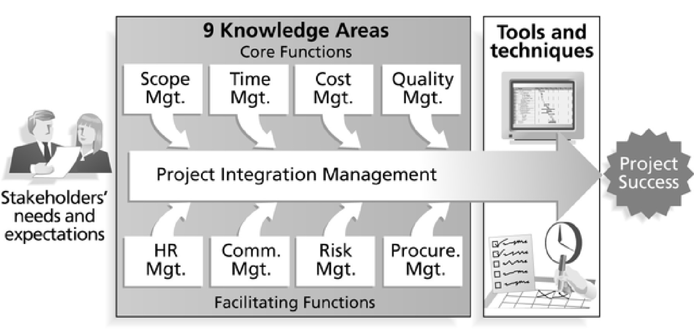

33

Slide 34
SW Project Management Plan
Assignment:
20%
34

Slide 35
Project Plan Content
Project Tile
Introduction/Overview
Justification of the Project
Objectives
Project Scope
Methodology
Project Management Phases
Software and Hardware Requirement
Software Development Model

Slide 36
…content
Project Management
Integration Management
Time Management
Cost Management
Quality Management
Human Resource Management
Communication Management
Risk Management
Procurement Management

Slide 37
…content
Abbreviations and Definitions
References
Annex

Slide 38
Instructions
Read your slides and reference materials to prepare your software project management plan
Every knowledge area is expected to have process, tools and techniques for its effective management
Use templates that we have mentioned during our lectures appropriately
Use MS Project 2007 for schedule, resource assignment and tracking strategies

Slide 39
Assignment Submission
Group size: Submission due date:
members
, 2019 (Tentative)
Via: monalitha@gmail.com

Slide 40
Important Dates
Final Exam:
, 2019
Article Review Presentation:
, 2019

Slide 41

ASSESSMENTS
Mid 30%
Final
40%
Arti. Review
10%
Assignment 20%

